Slide 1
CIRCLE Progress Monitoring Training
2015-16 School Year
Notes:
NOTE: Prior to training-all users should have access to the CLI Engage platform.
Teachers should have usernames and passwords and have previously logged into the system.

Slide 2
Why Do Teachers Assess? Using Data to Improve Practice
ASSESSMENT Collect Data.
EVALUATION Determine next learning step.
PLANNING Choose resources and approach.
TEACHING Supports students learning.
Notes:
Why is progress monitoring a critical component of the CLI Engage platform – it’s because we know that access to data improves teacher’s ability to plan instructional practice.
Data use models often look a lot like the teaching and learning cycle
In the cycle of effective teaching and learning, assessment is key.
Assessment: assessing the concepts or skills to determine each individual child’s level of understanding.
Evaluation: analysis of the assessment results to determine the next step in the instruction.
Planning: plan the next step and decide which approach to use and the resources needed.
Teaching: implement the plan by introducing a concept to the children or re teaching, guiding their understanding through practice and feedback.

Slide 3
Assessment Overview
CIRCLE Progress Monitoring is a newly revised version of the Center for Improving the Readiness of Children for Learning and Education (CIRCLE) Phonological Awareness Language and Literacy System (C-PALLS, 2004).
Over subsequent years, the assessment system was expanded to include math (2008) and science (2013). However, educators asked CLI’s team of researchers to develop an integrated assessment system that would cover the content included in the Head Start’s Assessment Framework.
Notes:
Read Slide

Slide 4
Why CIRCLE Progress Monitoring ?
Well -established reliability and validity when used with 3 and 4 year olds (relates to other tests and predicts child outcomes).
Designed to be administered quickly and yield immediate feedback and suggestions for teachers.
Texas School Ready model research demonstrates that the CIRCLE Assessment System and the activity groupings/suggestions improved child outcomes.
Notes:
Show slide
Say: The CIRCLE Assessment was designed to be used as a progress monitoring system within early childhood education settings (e.g., Head Start, Public School Pre-Kindergarten Programs and Childcare) for children ages 3.5 years (3 years, 6 months) through age 4 (4 years, 11 months). Current psychometric analyses focus on these age ranges.
CIRCLE Progress Monitoring is a formal assessment that provides immediate feedback. Results are on the screen.
Teachers, coaches, parents and administrators can all partner together to use the data to inform instruction.
Making sound decisions for instruction based on data is not only wise but standard practice.

Slide 5
What type of assessment?
CIRCLE Progress Monitoring is a screening and progress monitoring tool.
This is not a norm-referenced measure.
It is a criterion-referenced measure to screen and monitor preschool children’s learning.
Notes:
SAY:
CLI’s child progress monitoring program, the CIRCLE Progress Monitoring , is a user-friendly, online tool that allows the teacher to assess a child’s progress in a particular skill area almost instantly. This reliable yet simplistic data collection prompts teachers to focus on lessons that target their students’ least developed skill areas.
Early identification of learning needs and grouping children according those needs is known to maximize instructional impact.
Criterion referenced measures determine whether each student has achieved specific skills or concepts. Criterion referenced measures can also tell you how much students know before instruction begins and after it has finished.
(Norm –referenced measures rank each student with respect to the achievement of others in broad areas of knowledge. Norm referenced measures discriminate between high and low achievers).

Slide 6
CIRCLE Progress Monitoring
DIRECT
ASSESSMENTS
OBSERVATIONAL ASSESSMENTS
Vocabulary development
Story retell & comprehension
Book & print knowledge
Letter recognition
Letter-sound correspondence
Phonological awareness
Early science skills
Early math skills
Early social studies skills
Early writing skills
Social & emotional skills
Approaches to learning
Physical health & development
Notes:
SAY:
The CIRCLE Progress Monitoring Tool is a Multi-dimensional measure and also includes all Head Start domains
The Direct measures can be validated and have benchmarks.
core- rapid letter naming, rapid vocabulary, Phonological Awareness, Social/Emotional, early math
The CIRCLE Assessment Observables checklists are designed to assess growth in child behaviors that can be easily observed during day-to-day interactions between teachers and preschool students. Importantly, the checklists include attention to social and emotional domains that are not assessed with the other direct measures in CIRCLE Assessment. Understanding these domains is important for early childhood educators interested in understanding the development of the whole child across cognitive and social skills.
District users can set their own assessment windows The assessment is generally given three times in the year. BOY, MOY, EOY
(CLI recommends 3 x year)
Because the measures are brief the items can be easily validated and are more readily applied to benchmarks

Slide 7
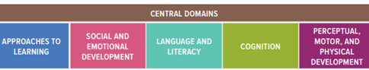
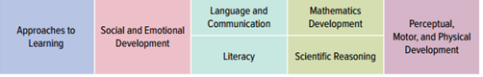
Head Start Child Development and Early Learning Framework
Notes:
CLI has added assessment components to now include all 10 essential domains of school readiness and is available in both Spanish and English (11th domain is ELL)

Slide 8
Head Start Domains and CIRCLE Progress Monitoring
Social & Emotional Development | Approaches to Learning | Language & Literacy | Cognition | Perceptual, Motor, and Physical Development
Positive Social Behaviors | Social/Emotional Approaches to Learning | Vocabulary development | Early Mathematics Skills | Fine and Visual Motor Checklist
Classroom Community and Safety | Initiative and Curiosity | Letter recognition Letter-sound correspondence | Early Social Studies Skills | Gross Motor Checklist
Emotion and Behavior Regulation | Flexibility | Early writing skills | Early Science Skills | Health Status Checklist
Self Care | Art, Creativity and Dramatic Play | Book & print knowledge
 |  | Story retell & comprehension
 |  | Phonological awareness
Notes:
Social Emotional, Physical Development & Health, and Approaches to Learning are 3 pt. scale checklists. based on emerging, developing and proficient
Math includes:
Rote Counting, Shape Naming, Number Discrimination, Number Naming, Shape Discrimination, Counting Sets and Operations
Phonological Awareness includes:
Listening, receptive and expressive rhyming skills, syllabication, sentence segmenting, alliteration and onset rime

Slide 9
Progress Monitoring Customization
Available in English and Spanish
Choose your own progress monitoring windows
Prioritize measures according to local needs
Exclude individual or classes of children as needed
Export data for independent analysis
Notes:
Explain each

Slide 10
Administering the Assessment
It is a good idea to not give the entire assessment at one time.
Break the assessment into parts. For example:
Week One: Phonological Awareness
Week Two: Rapid Letter Naming/Rapid Vocabulary
Week Three: Math Screener
Week Four: Observable
By administering the assessment this way you are able to complete an entire class within a month’s time.

Slide 11

Assessment Do’s & Don’ts of Assessment Administration
Praise effort.
Read instructions exactly as written.
Become comfortable with tasks before administering them.
Use prompts like “Listen carefully” to regain child's focus.
Model the practice activity if warranted.
Remain calm and steady.
Make notes after completing assessments.
Don't provide hints.
Don't elicit additional information.
Don't change instructions.
Don't assess children who are feeling sick, distraught, or overly oppositional.
Do not try to delete the assessment and change the answers
Do not model for a child once you have begun the assessment
Notes:
NOTE TO TRAINER
Participants take 1̶‒2 minutes to read through the list of Do’s and Don’t.
Allow participants to ask any questions if they are unclear on any items in the list.
PARAPHRASE:
Praise effort, not success. A child should not be able to tell if he or she got an item correct or incorrect. Some examples are:
“You are working hard.”
“You are doing a great job paying attention.”
“I am proud of your hard work.”
“You’re behaving so nicely.”
“Good listening.”
“I’m having fun playing these games with you.”
“You’re paying attention so well.”
“I can tell you’re working hard.”
If a child is uncertain about instructions, it is acceptable to read the instructions again.
Don't give hints to the child, or give praise that indicates how the child is doing/scoring. For example DO NOT say:
“Good”
“Great”
“Right”
“Uh-huh”
“You’re so smart”
Do not repeatedly say “okay/bien” between items.
Do not use facial expressions that reveal how the child is doing.
Do not give high fives during a test/between items.
Don’t change the instructions in any way – the administration should be consistent and standardized no matter which examiner gives the test.
How could a teacher who doesn’t follow the Assessment Do’s and Don’ts affect assessment results?
Do not give hints (i.e. nodding, clapping, tapping, yes/no responses) when administering the assessment.
Do not try to give additional information (i.e. we covered this last week, this letter makes this sound, this number comes after).
Do not change the instructions.
Do not assess while a child is sick, distraught, or in a fowl mood.
Do not try to delete the assessment and change the answers. True results are more effective.
Do not continuously click the keys when administering a timed test.
Do not model a skill for a child once you have begun the assessment. The practice time is the only time.
Do’s
Praise efforts, not success.
Read all instructions exactly as written.
Read the instructions again if a child is uncertain about them.
Be comfortable about the pace. Some assessments are timed.
Maintain and regain the child’s focus. Say things like, “Listen carefully.”
Remain calm and steady for children; especially with those who are emotional.
Minimize distractions. Try to assess during a time when other students are not around, and limit distractions.
Model the practice activity for the students.

Slide 12
Assessment Environment
Have the child sit beside you in a quiet area of the classroom to complete CIRCLE Assessment tasks.
Place the computer in a position that allows you to operate the keyboard while you and the child look the screen.
*Note: The child should not see the screen during the phonological awareness assessments.
Notes:
PA is auditory

Slide 13
Technology Essentials
To access the CLI Engage platform, you will need the following:
Desktop Computer, Laptop, or Tablet
Assessment cannot be administered on a device with a screen smaller than 11”.
Internet Access
Assessment can be administered offline.

Slide 14
CLI Engage Dashboard
Teachers will see a dashboard after logging in to www.cliengage.org

Slide 15
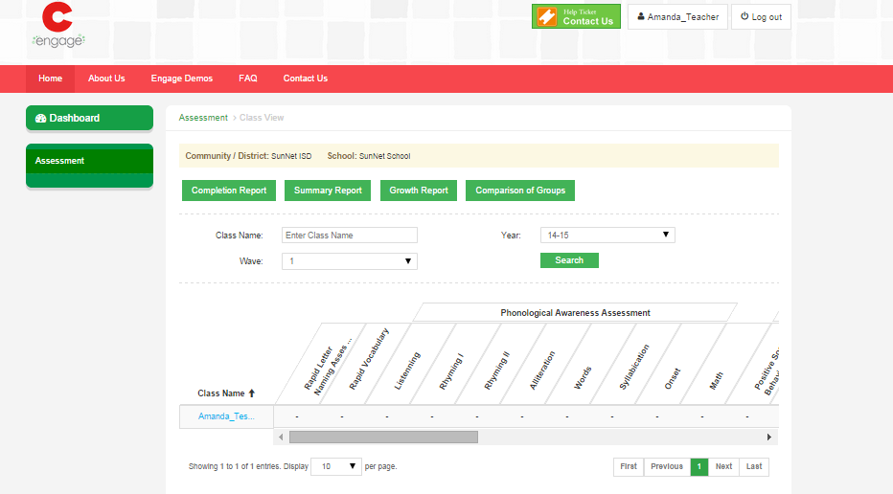
Accessing the CIRCLE Progress Monitoring System
Select “Assessment” on Dashboard
Select “Class Name”

Slide 16
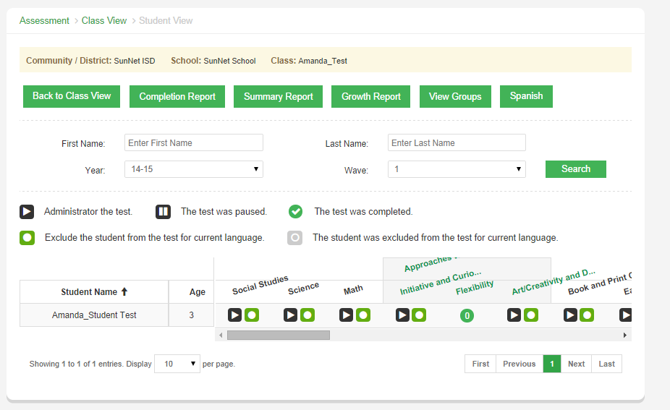
Class View Page
Notes:
School, Teacher, Time of Year (Wave)
Language Selection
Sort list by child
Color-coded levels of understanding based on benchmarks
Select measures to assess
-Walk through items (launch button, pause, etc.)

Slide 17
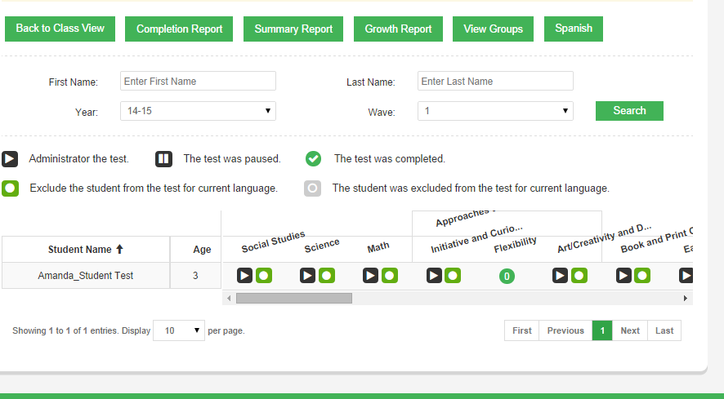
Class View
Select language of assessment.
Reports are available immediately after assessment completion
Select the appropriate “Wave.”

Slide 18

Launching an Assessment
Select multiple subtests and click “launch selected”, or
Select an individual subtest and click the “launch” button underneath the header

Slide 19
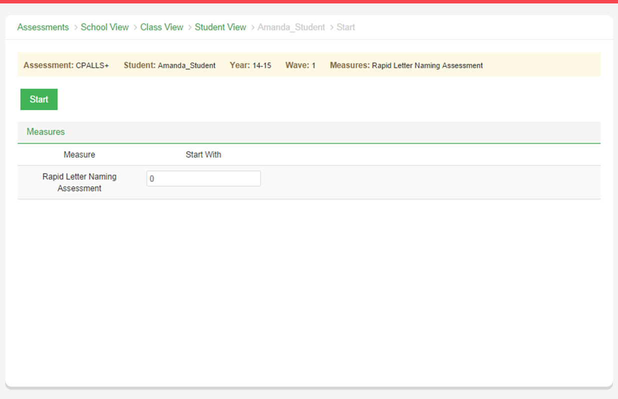
Extra Screen after “Launch”
Launch the assessment.
Skip the first screen by clicking “start.”
This is a screen you will see in each measure. Please click “start” to proceed with the assessment.
Notes:
This screen will appear before all measures. Please click “start” to proceed with the assessment.

Slide 20
Rapid Letter Naming
This assessment is given to evaluate a student’s ability to identify the alphabet.
The Rapid Letter Naming assessments are timed assessments.
The students will be given a total of 60 seconds to respond to the letters that appear on the screen.
Students must respond within 3 seconds. If 3 seconds elapse without a response it is automatically scored as incorrect.
When to Record the Response:
If the child correctly names the letter
If the child says “I don’t know”
If the child provides an incorrect response
Notes:
60-second timed assessments that provide a snapshot of what a child knows at that given time.

Slide 21
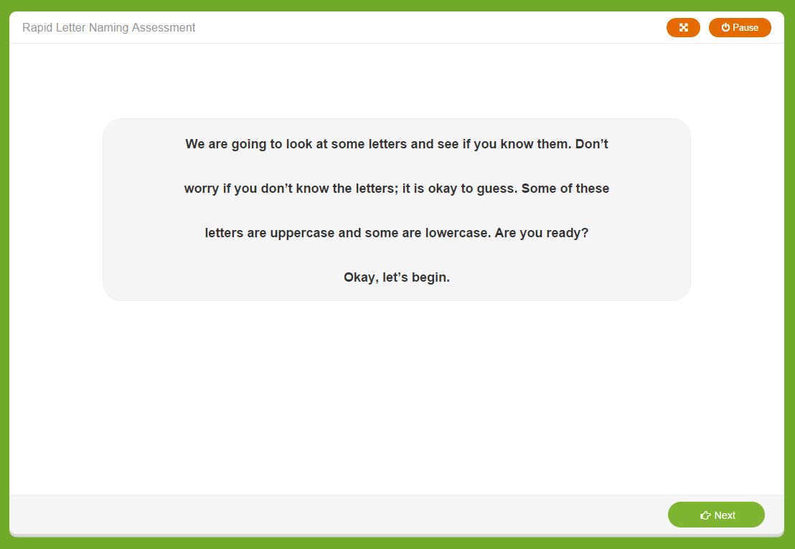
Introductory Page
Initial Instructions
Click “next” to launch timed assessment

Slide 22
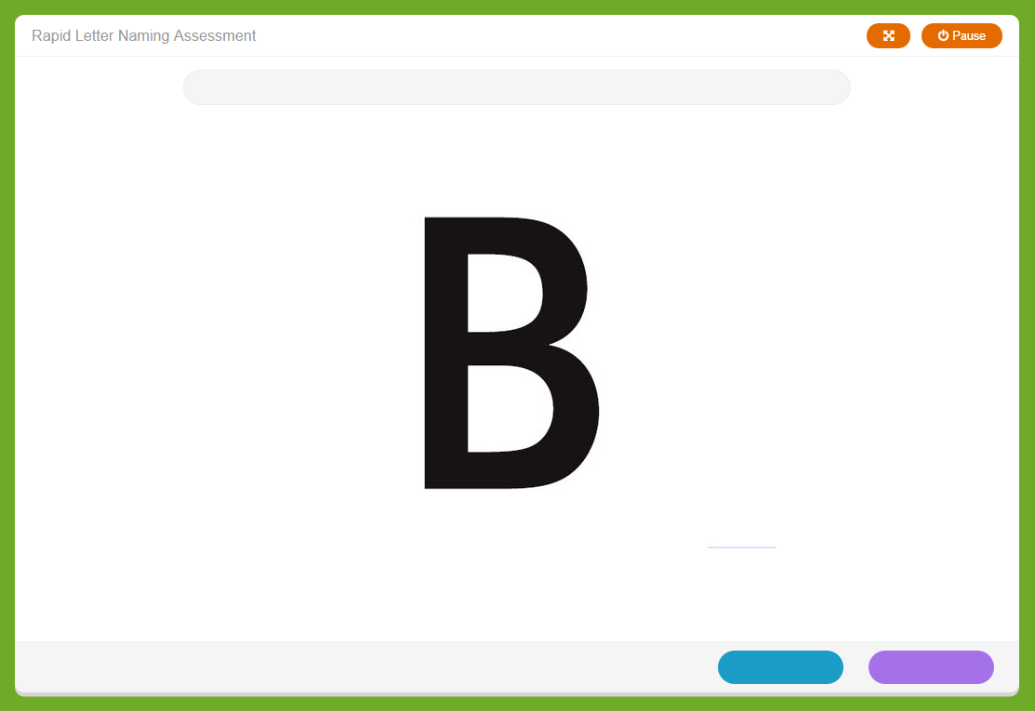
Sample Stimulus
Each item is timed - Students have 3 seconds to respond, Teacher has 1 second to key the response
Scoring Procedures:
Click blue if the student gave the incorrect response.
Click purple if the student gave the correct response.
Quick Key:
Left Arrow- Incorrect Response
Right Arrow – Correct Response

Slide 23
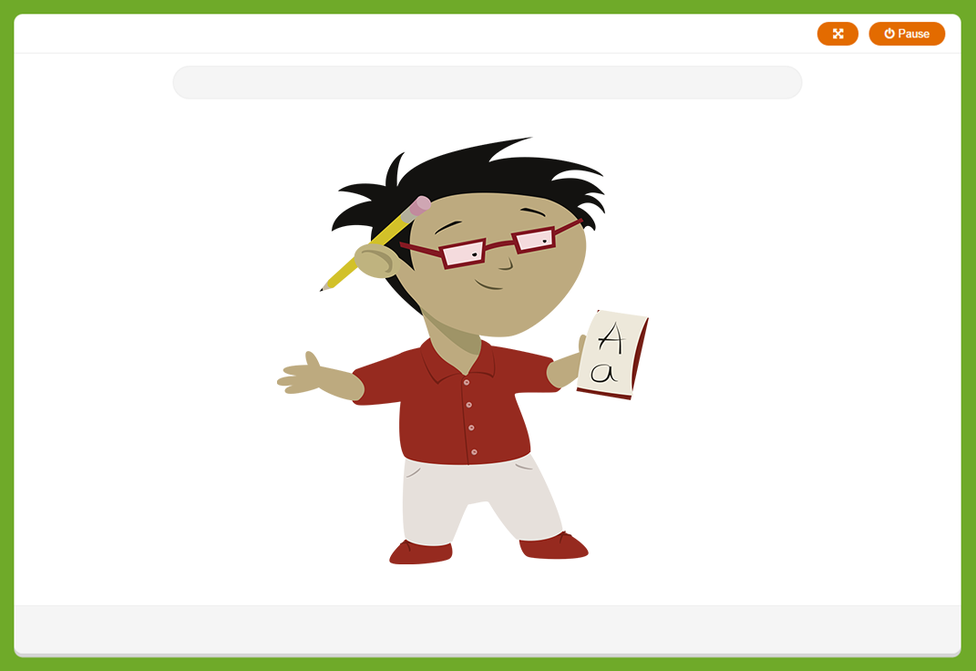

Closing Screen for Students

Slide 24
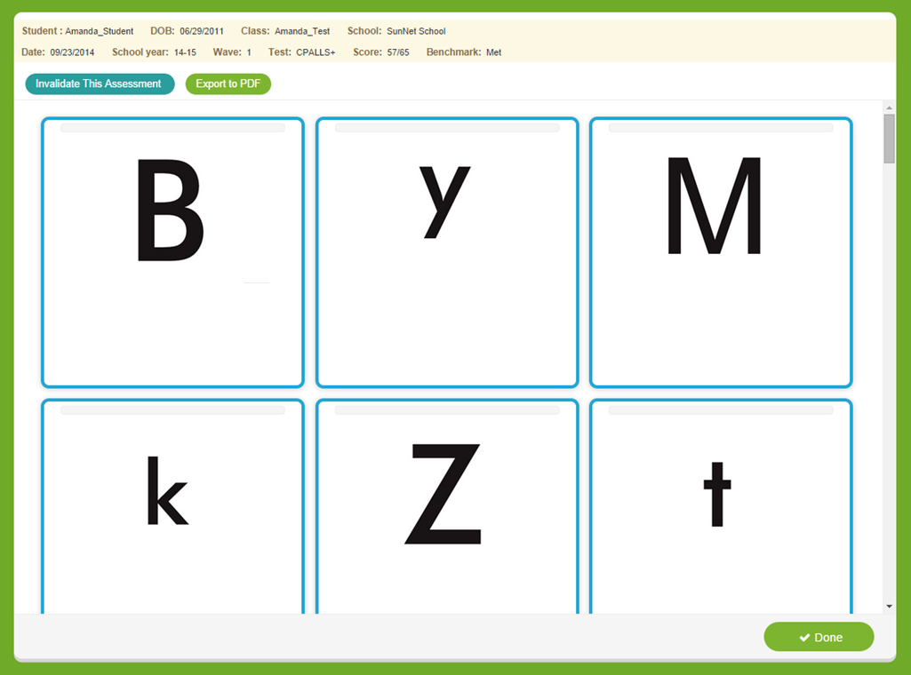
Results Screen
Student Score
Link to invalidate results if a scoring error was made
Individual responses that are color coded based on the child’s answer
Click “done” when you are finished reviewing results
Notes:
-How to invalidate the response
-Results
-Color correspondence (correct/incorrect)

Slide 25
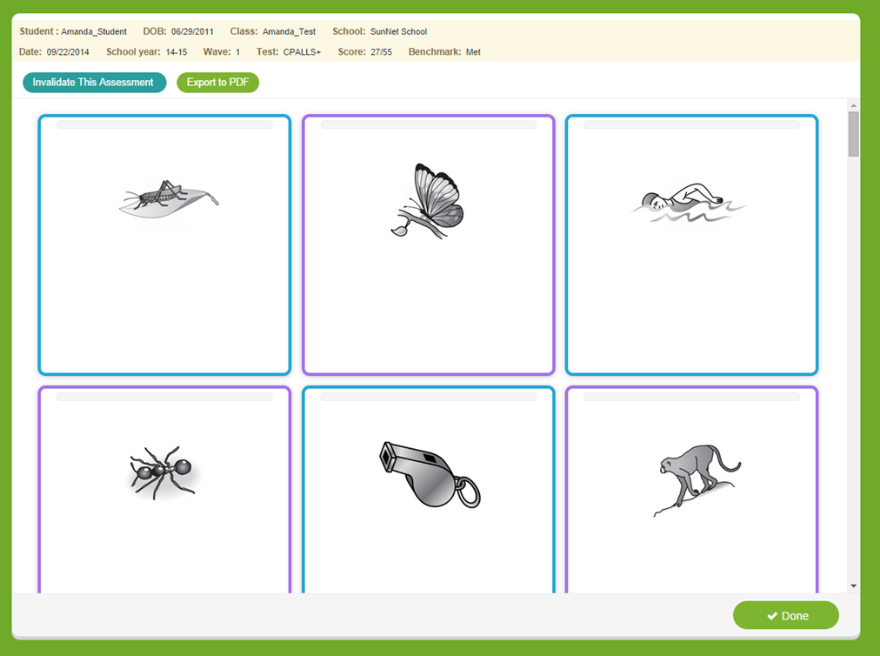
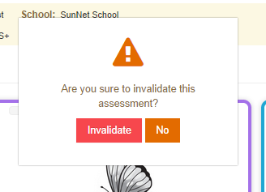
Invalidating an Assessment
Only invalidate an assessment if a scoring error was made by the teacher.
Do not reassess the child for several days to avoid “practice” effect.
Notes:
This process is consistent will all measure types.

Slide 26
Rapid Vocabulary Naming
These assessments are given to evaluate a student’s ability to identify vocabulary.
The Rapid Vocabulary assessments are timed assessments.
The students will be given a total of 60 seconds to respond to the pictures that appear on the screen.
Students must respond within 3 seconds. If 3 seconds elapse without a response it is automatically scored as incorrect.
When to Record the Response:
If the child correctly names the picture
If the child says “I don’t know”
If the child provides an incorrect response

Slide 27
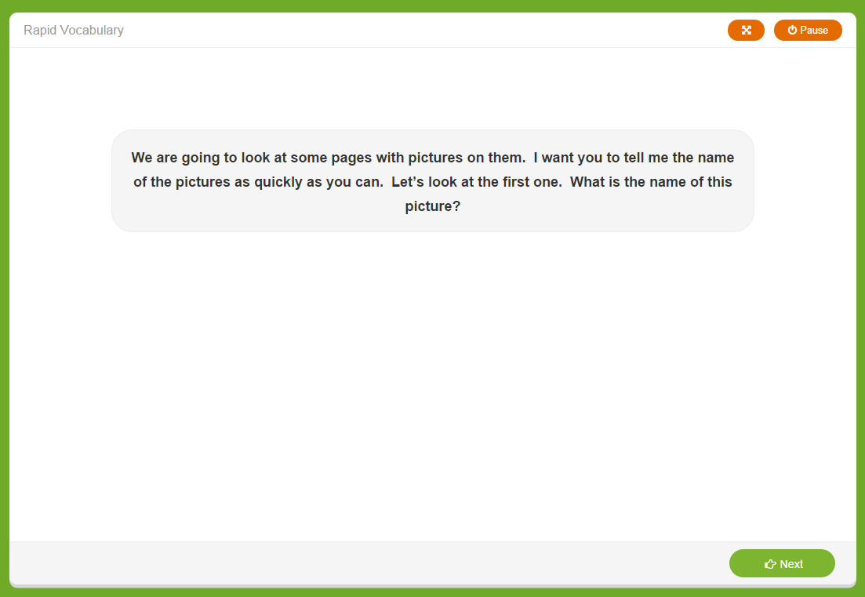
Introductory Screen
Initial Instructions
Click “next” to launch the untimed sample items
Notes:
Initial instructions for the teacher

Slide 28
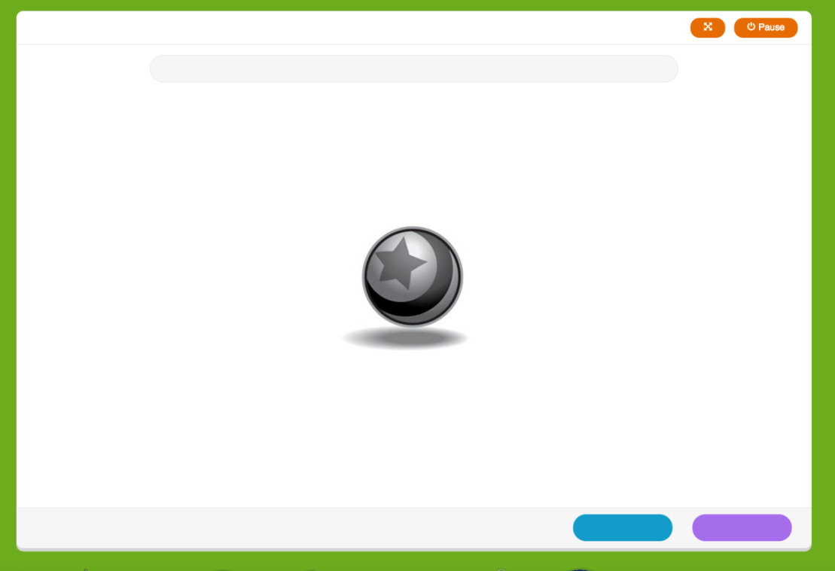
Warm-up Items
2 untimed warm-up items prior to the start of the timed assessment.
Click blue if the student gave the incorrect response.
Click purple if the student gave the correct response.
Quick Key:
Left Arrow- Incorrect Response
Right Arrow – Correct Response
“Right is right!”
Give feedback for both practice items:
Correct response: “Good job.”
Incorrect response: “That was a good try, but this is a ball. Let’s try some more. You say ‘ball.’
Notes:
-2 untimed warm-up items
-Click blue for “____”
-Click purple for “____”

Slide 29
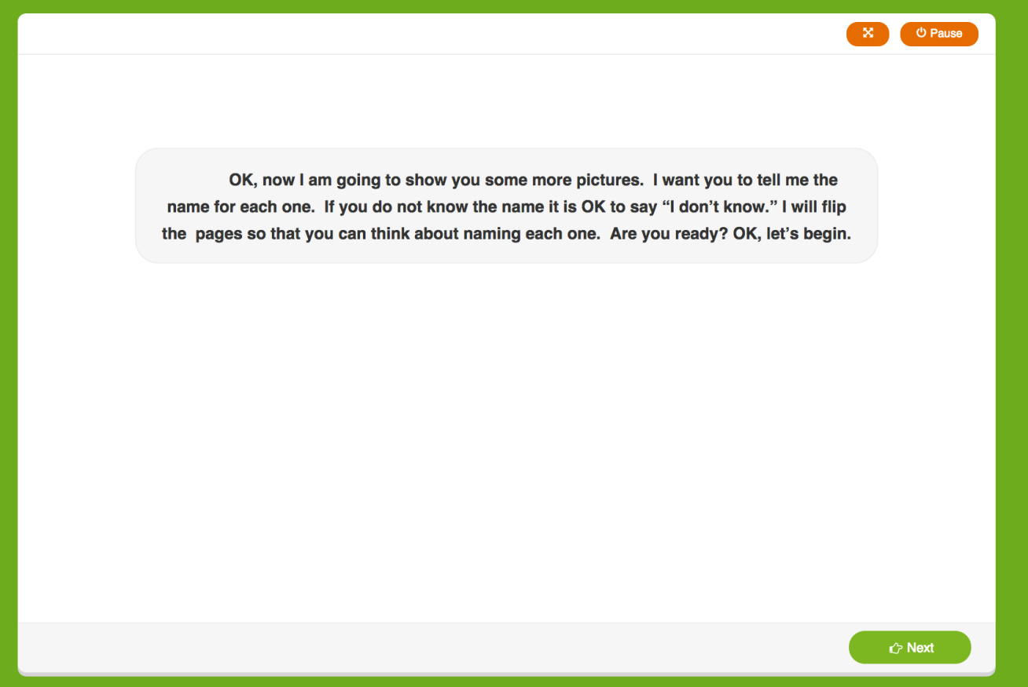
“Ready” Screen
Additional instructions for teacher to read aloud.
The teacher prompts are given on the screen and will guide the teacher through the assessment.
Child views assessment item on the screen.
Click “next” to launch the timed assessment.
Notes:
-Additional instructions for student.
-Click “next” to launch the timed assessment.

Slide 30
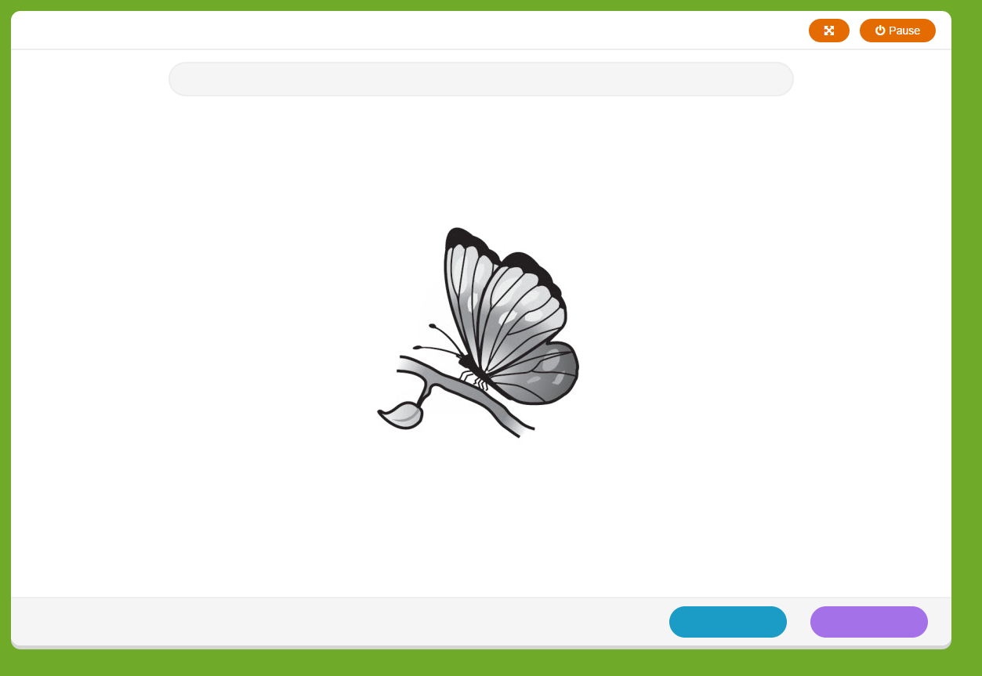
Sample Item
Each item is timed - Students have 3 seconds to respond, Teacher has 1 second to key the response
Scoring Responses:
Click blue if the student gave the incorrect response.
Click purple if the student gave the correct response.
You cannot correct responses without invalidating the assessment on the final screen.
Notes:
-Cannot correct responses without invalidating (which we will review). If you choose to invalidate, wait several days to re-administer to avoid a “practice” effect.

Slide 31

Closing Screen for Student

Slide 32

Results Screen
Student Score
Link to invalidate results if a scoring error was made
Individual responses that are color coded based on the child’s answer
Click “done” when you are finished reviewing results
Notes:
-How to invalidate the response
-Results
-Color correspondence (correct/incorrect)

Slide 33
Rapid Vocabulary Naming Administration Video
Click link to view:
http://content.cliengage.org/previews/a2njm7v8-upZaQlQy
Notes:
Watch Video-Discuss concerns from video assessment….

Slide 34
Rapid Vocabulary Group Practice
Log into assessments and click on the Rapid Vocabulary assessment.
Practice the assessment on your own.
Note: Participants may discuss afterwards if on an on-line discussion.
Notes:
Work with groups address any issues as they practice the assessment in Vocabulary

Slide 35
Phonological Awareness
This measure is used to assess a child’s understanding of sound in his/her language.
The Phonological Awareness assessments are not timed assessments.
The child does not look at the screen. This is an auditory assessment.
Note: It’s very important when scoring that the teacher be aware of what the correct answer from the child is. Sometimes the correct answer will be “no” and sometimes the correct answer will be “yes”.
Notes:
Phonological Awareness is the ability to detect the sounds in language without thinking about the meaning of what is said. It is considered a precursor to phonics and is a skill that is needed to learn phonics. In the Progress Monitoring Assessment, Phonological Awareness gauges a child’s understanding of how the sounds of spoken language can be segmented, combined and manipulated. --- Reminder that students should not see the screen for this assessment.
Review the slide.
** Onset/Rime is only administered to English speaking students. Spanish speaking students are exempt from this portion of the assessment.

Slide 36
Phonological Awareness Subtests
Listening | Ability to screen out other noises and selectively focus attention on a specific sound
Rhyming – Part 1 | Ability to distinguish if two words rhyme when spoken
Rhyming – Part 2 | Ability to independently give a word that rhymes with the word given
Alliteration | Ability to distinguish two or more words that have the same sound(s) at the beginning of the words
Words in a Sentence | Ability to move counters to show how many words are in a sentence
Syllabication | Ability to separate a word into its parts
Onset-Rime | Ability to blend two parts of a word together when segmented between the beginning consonant(s) and the rest of the word

Slide 37
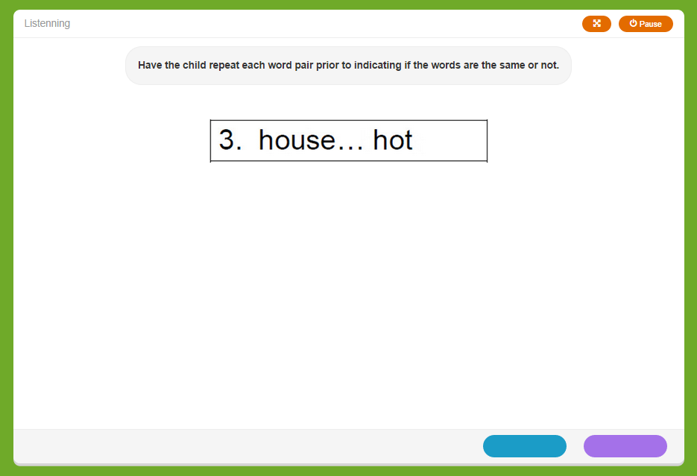
Sample Item
The teacher prompts are given on the screen and will guide the teacher through the assessment.
Scoring Responses:
Click blue if the student gave the incorrect response.
Click purple if the student gave the correct response.
Quick Key

Slide 38
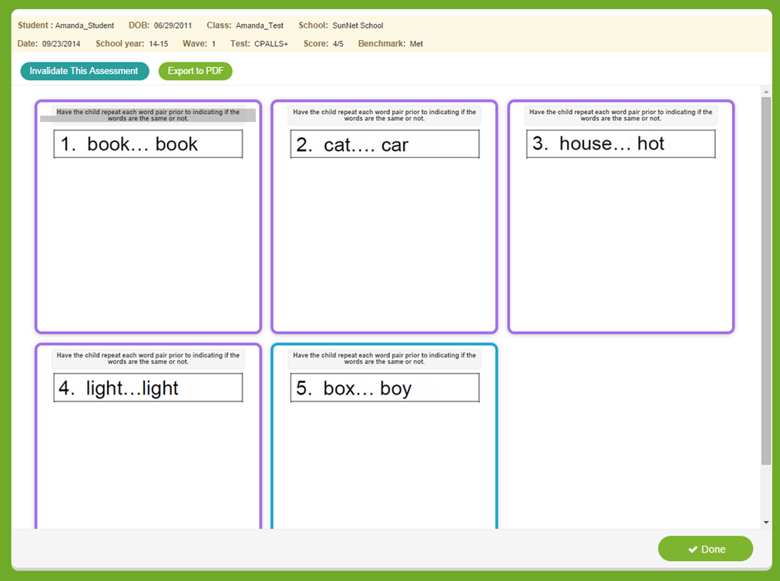
Results Screen
Student Score
Link to invalidate results if a scoring error was made
Individual responses that are color coded based on the child’s answer
Click “done” when you are finished reviewing results
Notes:
-How to invalidate the response
-Results
-Color correspondence (correct/incorrect)

Slide 39
Phonological Awareness Administration Videos
Click the links to view administration videos for the following assessments for Phonological Awareness. After the each video, log into the assessment and practice each component.
Listening
http://content.cliengage.org/players/D8DFyJvz-upZaQlQy.html
Rhyming I
http://content.cliengage.org/players/mWQSlbm4-upZaQlQy.html
Rhyming II
http://content.cliengage.org/players/D2iLTWEM-upZaQlQy.html
Note: Participants may discuss afterwards if on an on-line discussion.
Notes:
Begin with the Listening component of Phonological Awareness.-View video, pause after assessment to allow teacher an opportunity to log into the system and conduct the Listening Assessment under Phonological Awareness. Have a discussion with teachers about their experience while doing the assessment.
Possible questions: What was difficult about administrating the assessment?
What went well?
Over all impressions?
Continue viewing the video’s-pausing after each component to give teachers an opportunity to practice the assessment. Follow up with discussions for each section.
…

Slide 40
Phonological Awareness Administration Videos
Click the links to view administration videos for the following assessments for Phonological Awareness. After the each video, log into the assessment and practice each component.
Alliteration
http://content.cliengage.org/players/GaEuYOVc-upZaQlQy.html
Words in a Sentence
http://content.cliengage.org/players/H0tGsU88-upZaQlQy.html
Syllabication
http://content.cliengage.org/players/4dta0ocN-upZaQlQy.html
Note: Participants may discuss afterwards if on an on-line discussion.
Notes:
Begin with the Listening component of Phonological Awareness.-View video, pause after assessment to allow teacher an opportunity to log into the system and conduct the Listening Assessment under Phonological Awareness. Have a discussion with teachers about their experience while doing the assessment.
Possible questions: What was difficult about administrating the assessment?
What went well?
Over all impressions?
Continue viewing the video’s-pausing after each component to give teachers an opportunity to practice the assessment. Follow up with discussions for each section.
…

Slide 41
Phonological Awareness Group Practice
Log into assessments and click on any of the Phonological Awareness assessments.
Practice each Phonological Awareness assessment on your own.
Note: Participants may discuss afterwards if on an on-line discussion.
Notes:
Work with teachers as they complete Phonological Awareness assessments…

Slide 42
Math Component
The Math Screener is designed to diagnose strengths and weaknesses and to help focus instruction on specific areas of the child’s needs.
This assessment is not a timed assessment. The test are linked for continuation.
This assessment covers multiple tasks to assess a child’s understanding of math skills.
Notes:
Discuss slide

Slide 43
Math Tasks in CIRCLE Assessment
Rote Counting | Students successfully counts to the highest number in consecutive order
Set Counting | Students counts the number of items on the screen and give the number verbally
Number Naming | Students identify a picture of a number.
Number Discrimination | Students will pick out a specific number among other numbers
Shape Discrimination | Students will identify pictures of specific shapes among other shapes
Shape Naming | Students identify pictures of shapes
Operations | Students use addition and subtraction to respond the the question while referring to pictures on the screen
Notes:
Review components of Math Assessment…

Slide 44
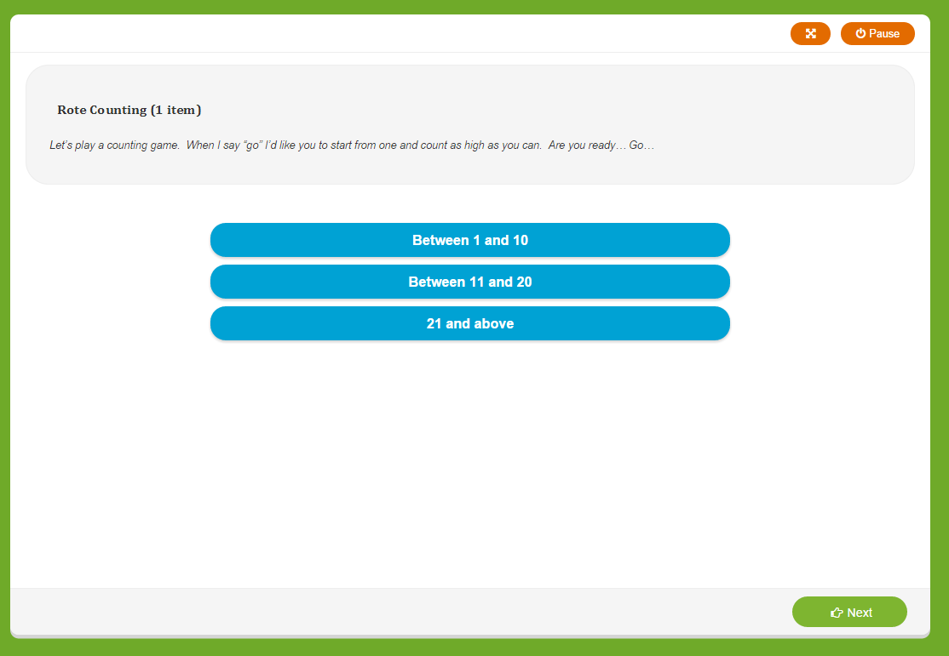
Task: Rote Counting
Give the directions to the child
Record highest response
(up to 99)
Click “next” to proceed.
Note: Repeat item up to 2x if needed
Prompt once if needed:
“OK, I will help you get started. 1, 2… what comes next?”
“What comes after ____?
Notes:
Discuss Slide on Rote Counting. Make note of special notes on slide
Repeat item up to 2x if needed
Prompt once if needed:
“OK, I will help you get started. 1, 2… what comes next?”
“What comes after ____?

Slide 45
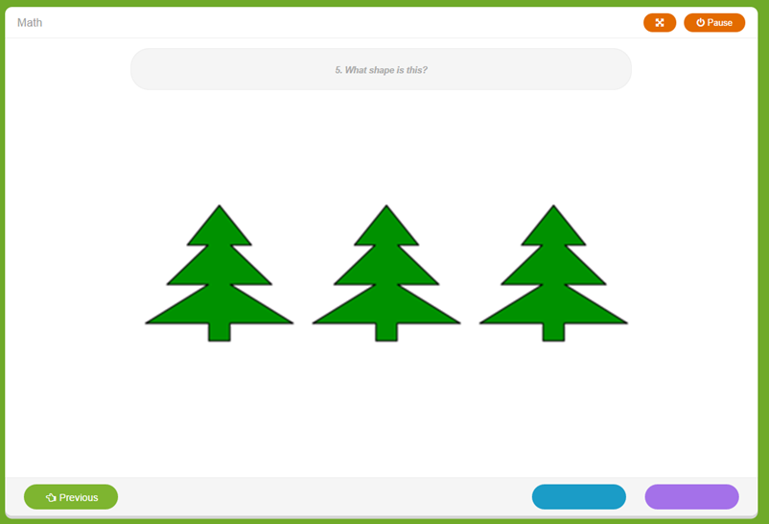
Task: Set Counting
Give the directions to the child
Ask the question
Click correct or incorrect button
Note: If the child just counts (e.g., 1, 2, 3), prompt for the cardinal value by saying, “How many are there?”
Notes:
Discuss slide: Set Counting
Note: If the child just counts (e.g., 1, 2, 3), prompt for the cardinal value by saying, “How many are there?”

Slide 46
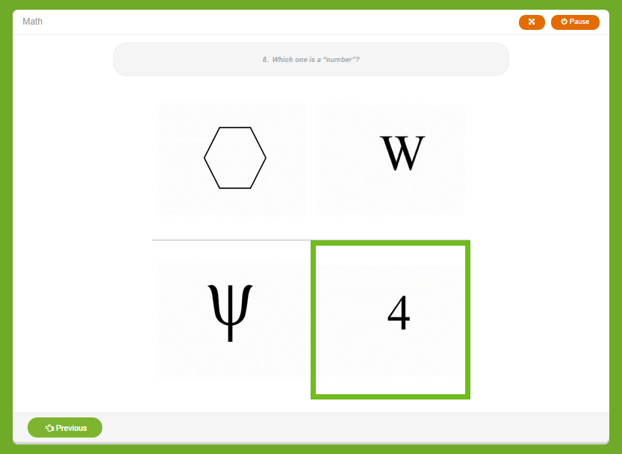
Task: Number Discrimination
Give the directions to the child.
Teachers clicks the child’s response. Answer choices highlight in green as they hover over an individual response.
Click “next” to proceed or “previous” to go back and correct and response immediately if a scoring error was made.
Notes:
Discuss Slide Number Discrimination

Slide 47
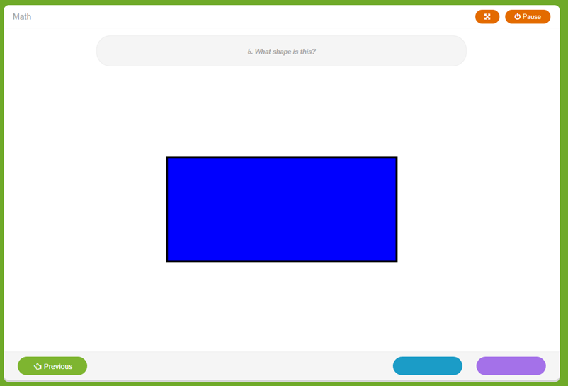

Task: Number Naming
Give the directions to the child
Ask the question
Scoring Responses: Click the correct or incorrect button
Notes:
Discuss Slide

Slide 48
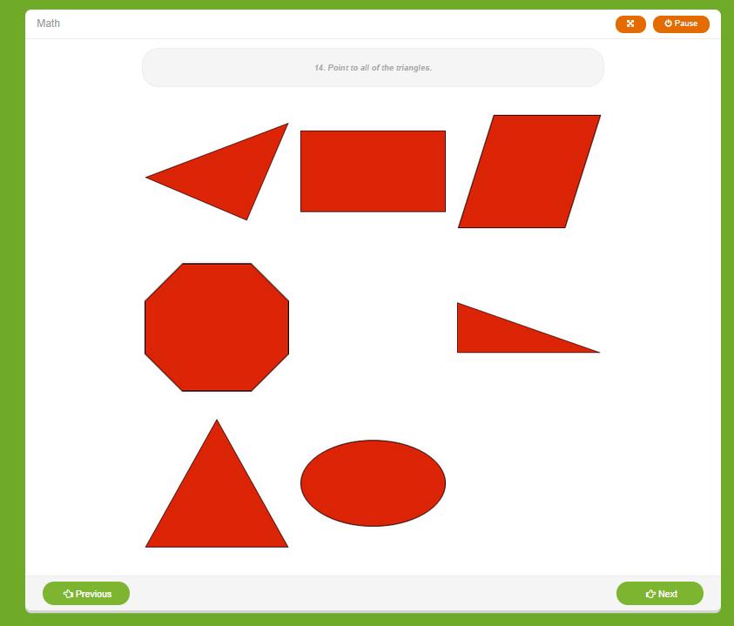
Task: Shape Discrimination
Give the directions to the child
Ask the question
Teacher highlights and clicks the child’s responses.
Click “next” to proceed or “previous” to go back and correct and response.
Note: If the child points to 1 or 2 _______, teachers can use the following prompt one time: “Is that all of them?”
Notes:
Discuss Slide

Slide 49
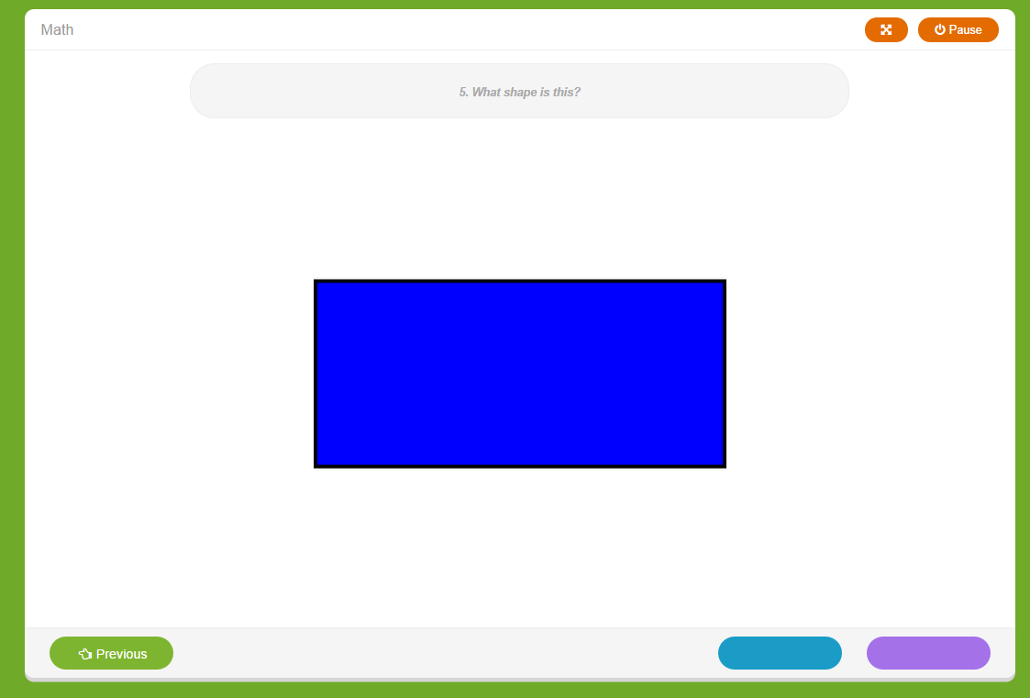
Task: Shape Naming
Give the directions to the child & ask the question
Scoring Responses:
Click blue if the student gave the incorrect response.
Click purple if the student gave the correct response.
Quick Key
“Previous” button allows you to go back and correct a response.
Notes:
Discuss Slide

Slide 50

Task: Operations
Give the directions to the child
Ask the question
Click correct or incorrect button
If you took away one drink how many would be left?
Notes:
Discuss Slide

Slide 51
Closing Screen for Student
Notes:
Discuss Slide

Slide 52
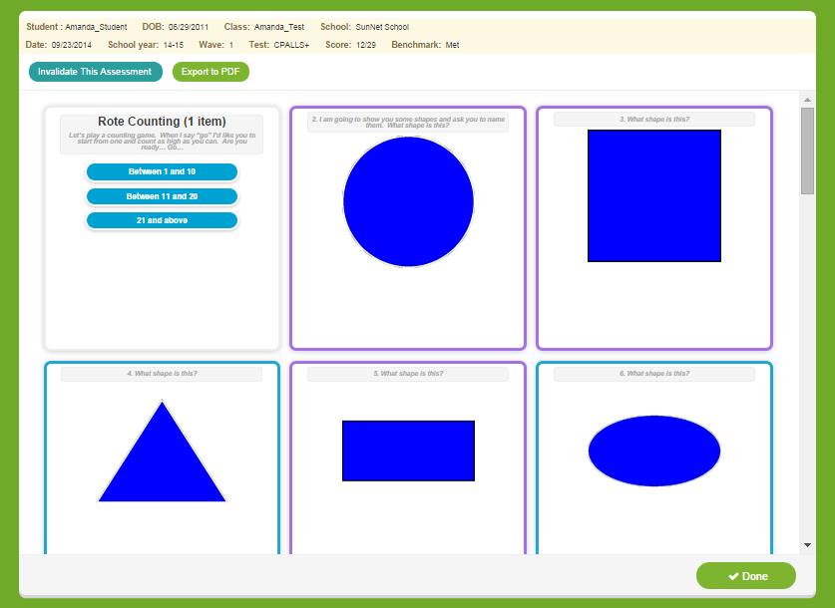
Results Screen
Student Score
Individual responses that are color coded based on the child’s answer
Click “done” when you are finished reviewing results
Notes:
-How to invalidate the reposne
-Results
-Color correspondence (correct/incorrect)

Slide 53
Math Administration Video
Click link to view:
http://content.cliengage.org/players/JJ978sJR-upZaQlQy.html
Notes:
Watch Video-Discuss concerns from video assessment….

Slide 54
Math Group Activity
Log into assessments and click on any of the Math Components.
Practice each Math Component on your own.
Note: Participants may discuss afterwards if on an on-line discussion.

Slide 55
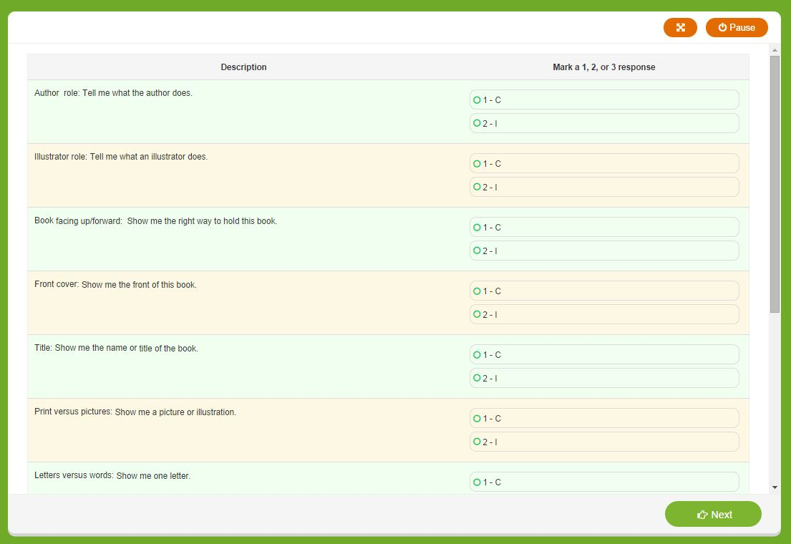
Book & Print
Book and Print Checklist: observes the child’s engagement and awareness of books and print.
Select a book with these features:
Print on every page
At least one page with multiple lines of print
No more than three lines of print on each page
Print that moves from left to right
Teacher gives directive and selects “Correct” or “Incorrect” based on the student’s response,
Notes:
-Auditory/No screen prompts for students

Slide 56
Book and Print Administration Video
Click link to view:
http://content.cliengage.org/players/ijorimay-upZaQlQy.html

Slide 57
Book and Print Group Practice
Log into assessments and click on the Book and Print Assessment.
Practice the Book and Print assessment on your own.
Note: Participants may discuss afterwards if on an on-line discussion.

Slide 58
Science and Social Studies
Teachers will administer receptive tasks in the social studies and science assessments. These assessments are optional for TSR Comprehensive participants.
Note: Even though these assessments are optional for the TSR Comprehensive project, Districts may require your sites to complete these assessments.

Slide 59
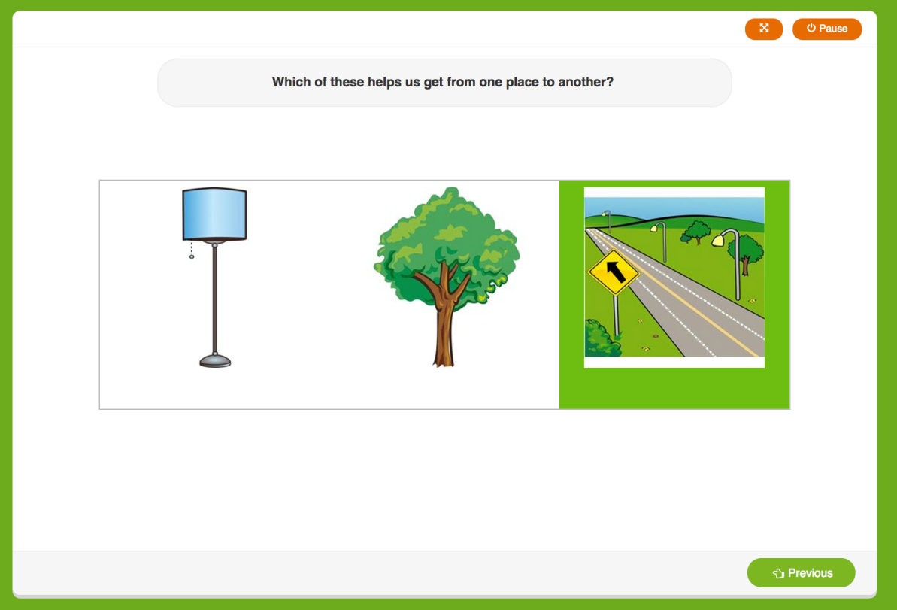
Sample Item
The teacher prompts are given on the screen and will guide the teacher through the assessment.
By hovering over a response, it highlights green.
Click to select the response given by the student.
“Previous” button allows you to go back and correct a response if a scoring error was made.

Slide 60
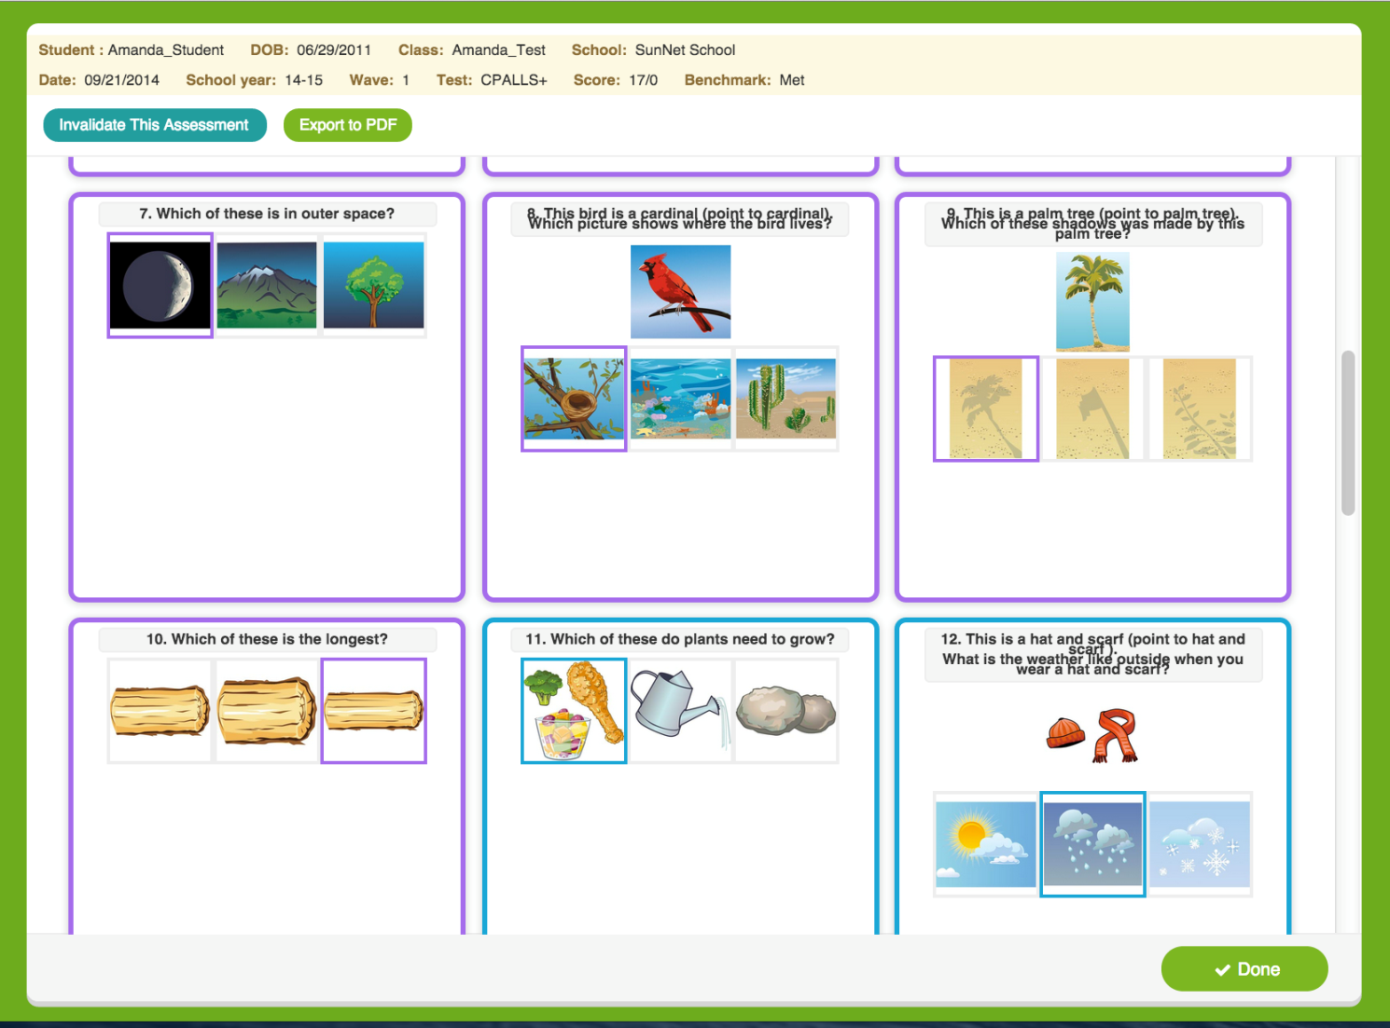
Results Screen
Student Score
Individual responses that are color coded based on the child’s answer
Click “done” when you are finished reviewing results

Slide 61
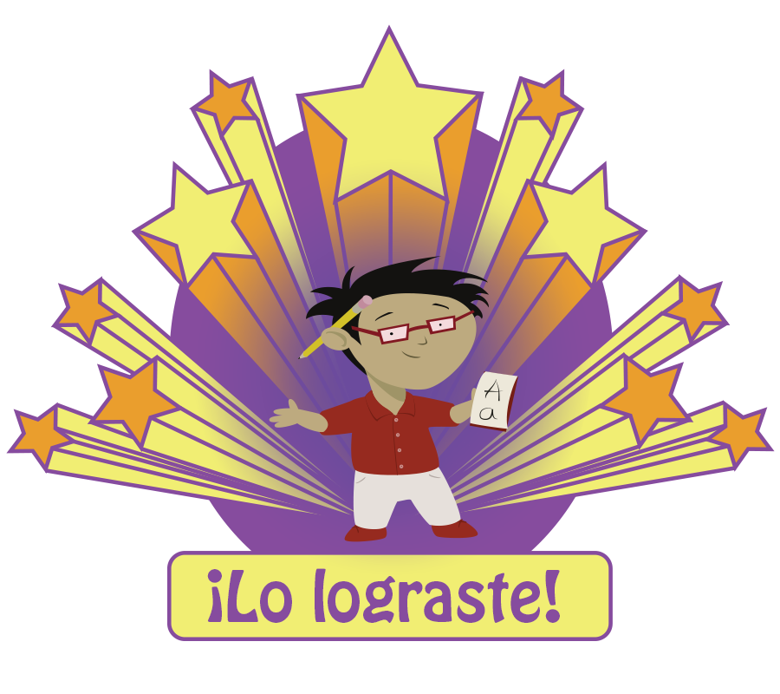
Closing Screen for Student
Notes:
-Student name, DOB
-Score – Whether they met the benchmark
-Items that were answered correctly or incorrectly – color coded – Purple = ?

Slide 62
Observables
The components of the Observables include:
Social Screener
Early Writing Checklist
*Physical Development and Health
*Approaches to Learning
Notes:
A teacher’s recorded observations, gathered across time, can help with:
Tailoring classroom environment and activities to meet children’s needs.
Track a child’s social, cognitive, and emotional development.
Identify a child’s strengths and interests.
Share with parents, supervisors, advisors, and coaches.
Make modifications in the curriculum.
Once this information is collected, a teacher can create a portfolio of information on the student. It will provide both the teacher and the parent a picture of a student’s learning, and reflect his/her progress in a particular area.
Review the slide.
The observables must be done at the conclusion of the assessment period.

Slide 63
Observables Administration Video
Click link to view:
http://content.cliengage.org/players/EDQLDYmD-upZaQlQy.html
Notes:
Begin by viewing the instructional video on Observables and then have teachers log into the system and practice any part of the checklist. After completing discuss with teachers.

Slide 64
Observables Group Practice
Log into assessments and click on any of the components in the Social Emotional checklist.
Practice each Social Emotional checklist component on your own.
Note: Participants may discuss afterwards if on an on-line discussion.

Slide 65
Reports
Class Summary
Grouping Tool
Child Summary
Letter
Vocabulary
Phonological Awareness
Math
Campus Report
Notes:
CIRCLE Progress Monitoring provides you with several different Reports.
(Review each type of report as listed on the slide.)
We will look at each of these reports in detail.

Slide 66
CIRCLE Progress Monitoring Reporting
Completion Report: tracks completion of required assessments
Summary Report: allows districts and communities view children’s performance across all subject areas
Growth Report: allows districts, communities, and teachers to view children’s gains over time
Group Report: groups children with scores below age-related benchmarks and recommends activities for further skill development
Notes:
HOW administrators can use reports and how the information can be given to parents
BENCHMARK REPORT!
-

Slide 67
Class Summary
Provides:
Overview of assessments for your class
Snapshot of your children’s literacy and math skills
Notes:
The class summary shows each child in the classroom and their scores on each part of the CIRCLE Progress Monitoring . This will give you an overall picture of the assessment for your entire class. It is a snapshot of the literacy and math skills of your children.
You may remember from your CIRCLE Progress Monitoring training that the scores are color-coded. Four-year old children will have “green” and “red” scores, which correspond to “satisfactory” and “emerging” skills. Three-year olds will have “green” and “yellow” scores. If more than half of your class has a “red” or “yellow” score, then you should focus on that skill in your whole group instruction.
Ask: If half your class shows a “red” or “yellow” score in Letter Knowledge, how would you address that in large group instruction? (Read alphabet books, play letter wall games, do letter knowledge transitions, etc.)
Let’s look at some ways to improve your whole group instruction in language and phonological awareness.

Slide 68
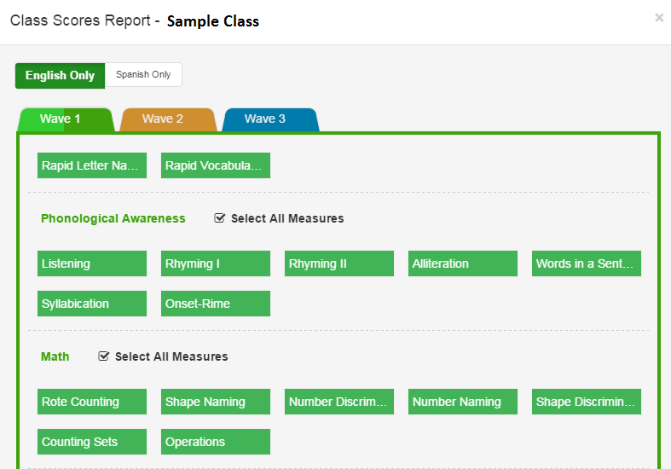
Summary Selection Page
Notes:
The class summary shows each child in the classroom and their scores on each part of the This will give you an overall picture of the assessment for your entire class. It is a snapshot of the literacy and math skills of your children.
(Consider projecting a sample class summary or ask participants to look at the one they brought as you explain the Class Summary.)
You may remember from your CIRCLE Assessment System training that the scores are color-coded. Four-year old children will have “green” and “red” scores, which correspond to “satisfactory” and “emerging” skills. Three-year olds will have “green” and “yellow” scores. If more than half of your class has a “red” or “yellow” score, then you should focus on that skill in your whole group instruction.
Ask: If half your class shows a “red” or “yellow” score in Letter Knowledge, how would you address that in large group instruction? (Read alphabet books, play letter wall games, do letter knowledge transitions, etc.)
Let’s look at some ways to improve your whole group instruction in language and phonological awareness.

Slide 69
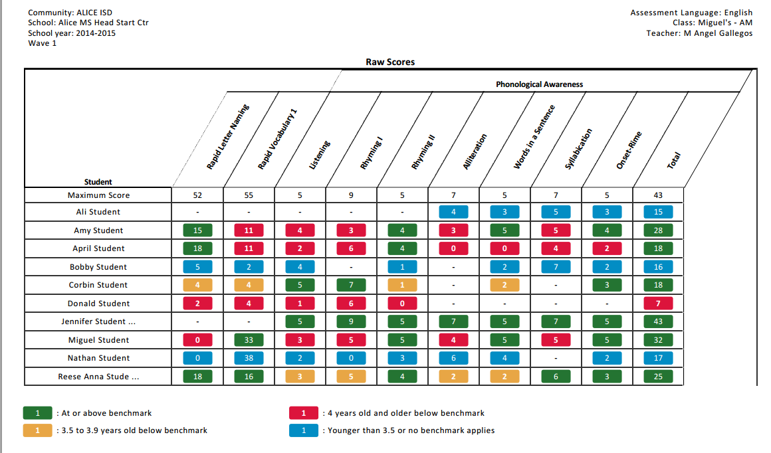
Class Summary Report
Notes:
Student name, DOB, Class and School
-School year, Wave (1,2, or 3), Score, and whether the child met the benchmark
-Option to Invalidate this assessment – note that it should be given several days later
-Export to PDF
-Done = Results are recorded and visible on the student summary page
-Individual answer responses - Color correspondence (correct/incorrect)

Slide 70
What is Response to Intervention (RTI)?
Tier 2
supplemental small groups (~15%)
Tier 1
core curriculum (~80%)
Tier 3
intensive, individualized interventions (~5%)
Notes:
Assessment allows us to know who is tier 1, 2 etc. Progress monitoring results generate tier 2 small groups for more targeted instruction.
Tier 3 is generally not indicated from an initial screening like CIRCLE assessment, but from lack of progress in tier 2
Children identified as at-risk receive more frequent, more intensive, and/or different types of instruction, often in small groups (Tier 2 in the RTI framework). Continued assessment may further inform instruction, such as the need for individualized attention (Tier 1).

Slide 71
Whole Group Language Instruction
Conversations
Questions
Read-Alouds
New vocabulary
Language building strategies
Themes
Notes:
Whole group language instruction can be used to increase the skills of the entire class when needed. Whole group instruction should focus on:
Engaging children in extended conversations
Asking questions to encourage critical thinking
Reading aloud daily
Encouraging children to retell stories
Modeling use of new and unusual words
Using language building strategies (label, describe, compare, explain, link)
Discussing word meanings
Using themes (discussing topics & concepts in context)
Extending themes into centers
(Encourage participants to give additional ideas.)

Slide 72
Whole Group Phonological Instruction
Daily PA instruction
Variety of PA activities
Increase level of difficulty
Connect to themes
Books that include PA elements
PA activities in centers
Notes:
Whole group phonological awareness instruction can be used to increase the skills of the entire class when needed. Whole group PA instruction should focus on:
Engaging children in daily PA instruction
Providing a variety of PA activities based on the continuum
Increasing level of difficulty as knowledge increases
Connecting PA activities to themes
Including PA activities in children’s play
Using books that include PA elements
Providing hands-on PA activities in centers
(Encourage additional ideas from participants.)

Slide 73
Grouping Tool
Provides:
Recommended children for small group instruction
Small group activities
Notes:
The grouping tool breaks children into groups for you based on their assessment results. The groups will contain children that have not yet reached the “satisfactory” level for each skill. These children need more practice with certain skills and will benefit from small group instruction. Suitable small group activities from the CIRCLE Online Activities are listed on the View Groups button.
Ask: If you see more than half of your children in a certain group, what does that mean? (You need to incorporate that skill into more large group instruction.)
(Consider showing a sample Group)

Slide 74
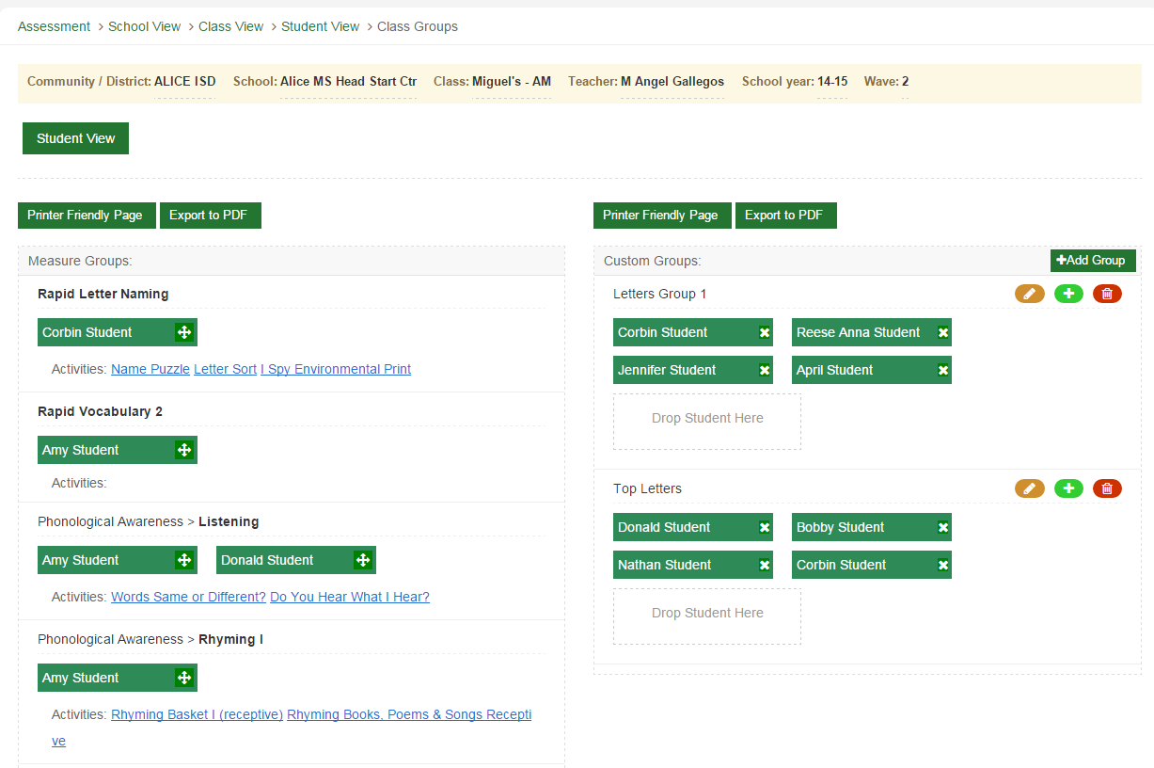
Grouping Tools
Notes:
Show how to create a group and how to view reports

Slide 75
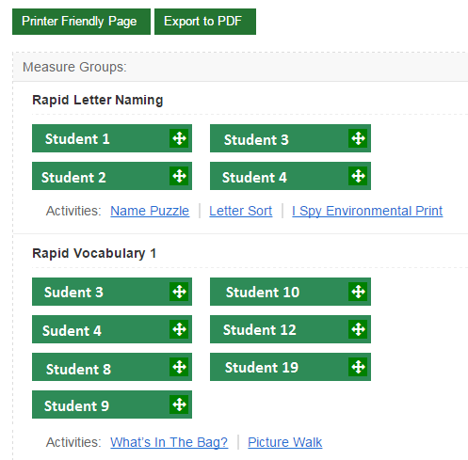
View Groups

Slide 76
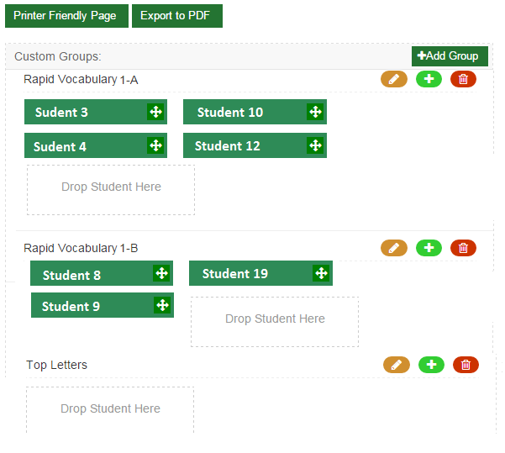
Custom Groups

Slide 77
Benefits of Small Group Instruction
Give children more opportunities to use language with the teacher and peers
Observe children individually
Scaffold children’s development
Meet children’s individual needs
Reduce wait time for children
Allow for more individual participation from each child
Notes:
Small group instruction is so beneficial for young children. Through small group instruction, you can:
(Read slide)

Slide 78
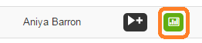
Creating Reports
Class Summary
Child Summary
Grouping Tool

Slide 79
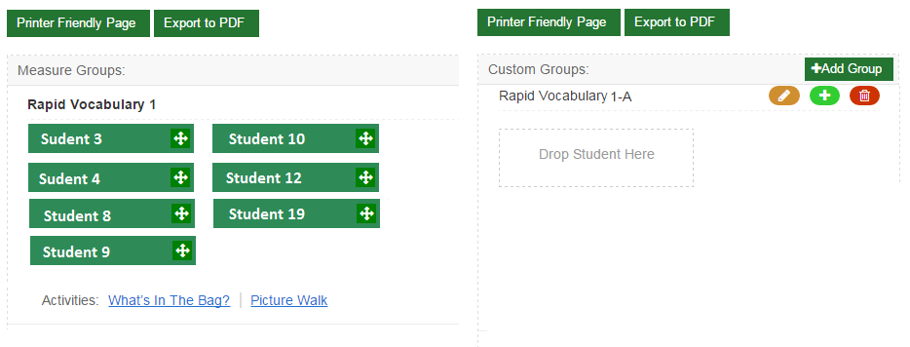

Drag and Drop

Slide 80
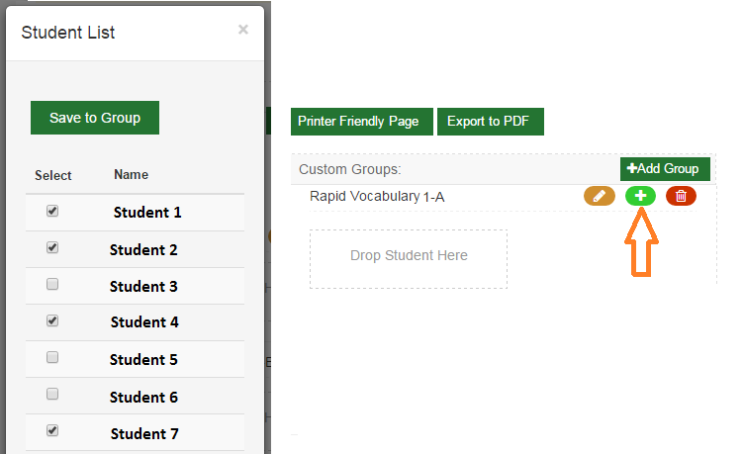
Select from List

Slide 81
Child Summary
Provides:
Child’s overall results
Individual task results
Notes:
The next type of Web Report we will look at is the Child Summary report. The Child Summary report show’s an individual child’s assessment results. If individual children are struggling with a particular skill, you should plan specific activities for that child addressing the needed skills. This could include independent center activities, individual instruction, or even asking the parent to do certain activities at home to help the child.

Slide 82
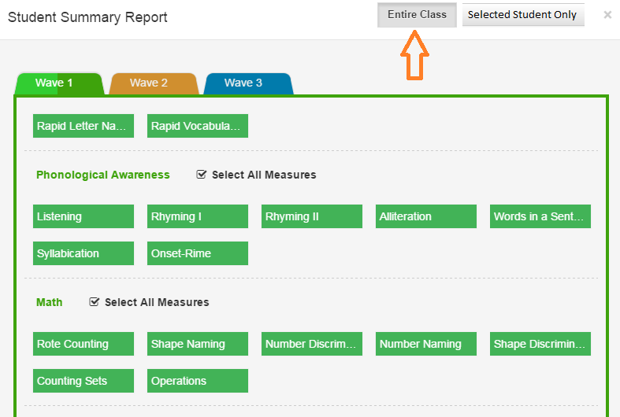
Summary Selection Page
Notes:
The next type of Web Report we will look at is the Child Summary report. The Child Summary report show’s an individual child’s assessment results. If individual children are struggling with a particular skill, you should plan specific activities for that child addressing the needed skills. This could include independent center activities, individual instruction, or even asking the parent to do certain activities at home to help the child.
(Consider projecting a sample Child Summary)

Slide 83
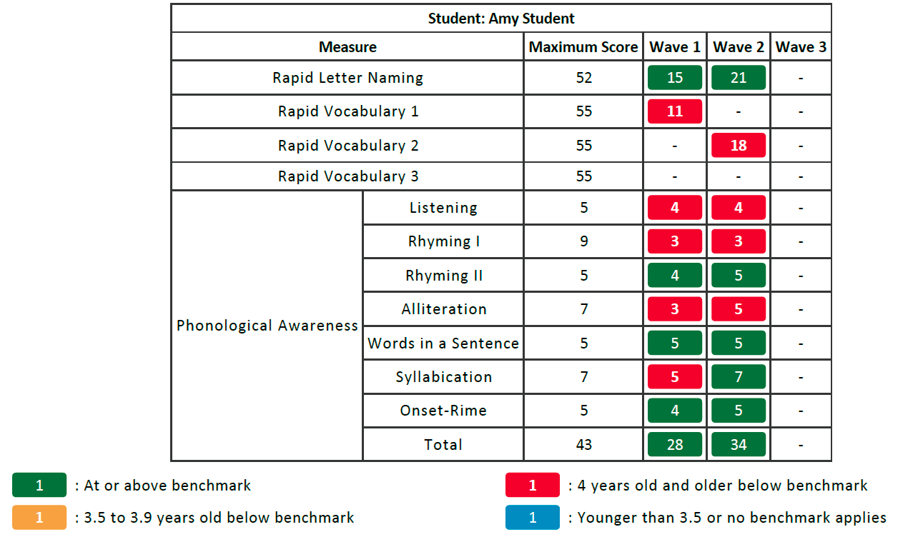
Student Summary Report

Slide 84
Planning intervention
Use the small grouping tool
Use CIRCLE online activity collection
Utilize CLI Engage on-line Professional Development for teachers
CLI Engage CIRCLE Activity collection.
Notes:
Discuss slide -opportunities for interventions with Teachers

Slide 85

If you need assistance…
Submit a “Help Ticket” through the CLI Engage Dashboard.
Questions will be addressed by trained CLI staff members.

